Slide 1
Date: 19/09/2022
Sustainable Manufacturing Project
TITLE – Denim Supply Chain
NAME(ID) – Chaitanya Krishna Chauhan (2020A4PS1869P)
Supervisor : Professor Kuldip Singh Sangwan
Department of Mechanical Engineering

Slide 2
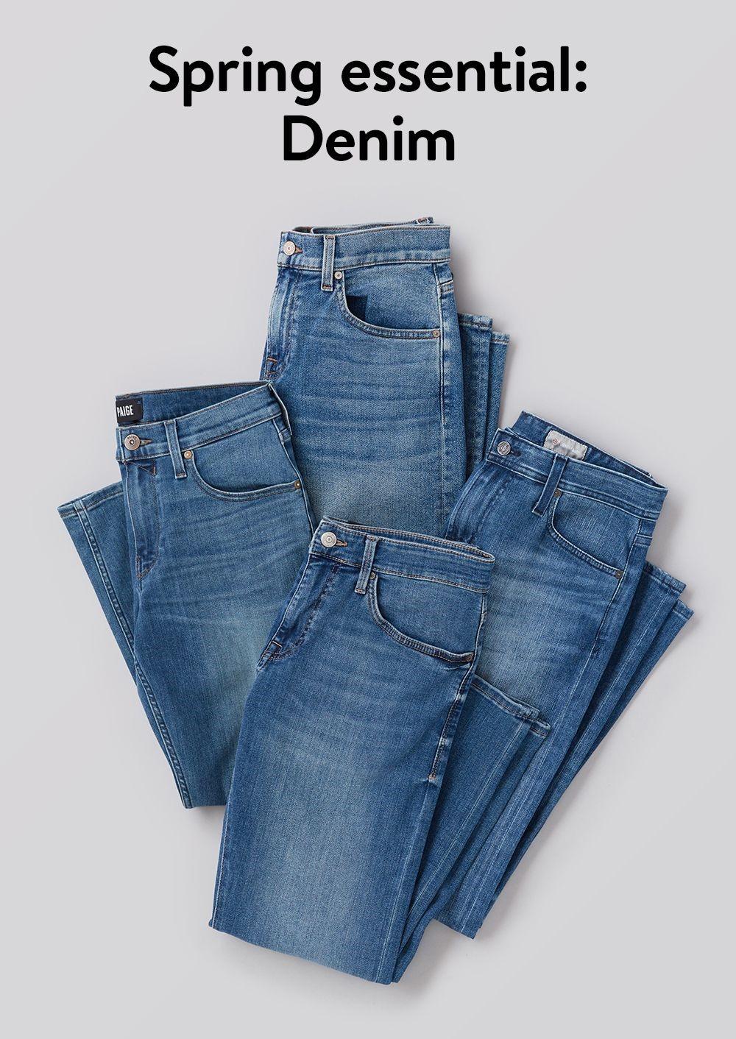
Aim
The aim of this project is to highlight the environmental issues in the production
of jeans and the required techniques to
overcome these barriers to achieve
sustainable development.

Slide 3
Motivation
The main motivation behind selecting this topic was the overconsumption of water in the Denim industry which is ecologically harmful and a hindrance to sustainable development.
Estimates show that around 10,000 litres of water, a pound of chemicals, and a huge amount of energy is used in producing a pair of jeans. The amount of carbon footprints being produced is also increasing manifold and is one of the largest in the fashion industry. If we multiply it by the number of jeans being produced globally, the results are even worse. Thus, we need to adopt green manufacturing in the field of Denim production for sustainable development.

Slide 4
Introduction
Denim is a fabric which is woven with indigo-dyed cotton yarn. It has been in use since the late eighteen century. It was mainly designed as a work wear for miners due to it’s rugged nature.
The major steps involved in Denim production are :
Yarn manufacturing
Dyeing
Weaving
Processing
Washing and Drying

Slide 5
Introduction
Denims were initially made to withstand hard labour but now it has become more of a fashion. The Major Sustainability issues in Denim supply chain and Jeans production are :
Huge amount of water consumption. ( 7600 litres of water )
Large amount of carbon footprints. (33.4 kg of Carbon equivalent)
Use of harmful chemicals and pesticides. (Environmental degradation)
Unchecked disposal of waste materials and dyes. (Water pollution)
Child labour in cotton fields. (Chronic diseases like ‘Silicosis’ upon exposure to hazardous chemicals and methods like ‘Sandblasting)

Slide 6
Methodology
We need to adopt sustainable measures in Denim production supply chain to promote green manufacturing. Some of the ways we can achieve it are listed below :
Industry
Use of organic cotton.
Natural indigo dyes.
Lean Manufacturing
Dry techniques : Scraping, Grinding and Distressing.
Recycling of used Denims through shedding.
Green Manufacturing
Use of Eco-friendly sulfur dyes instead of indigo.
Water treatment plants to reduce the water consumption in Denim Production.

Slide 7
References
How ethical is the denim supply chain?
https://www.transparency-one.com/how-ethical-denim-supply-chain/#:~:text=Weaving%3A%20Denim%20jeans%20begin%20in,and%20horizontal%20threads%20(weft).
Levi’s Sustainability report.
https://www.levistrauss.com/sustainability-report/
3. Denim Jeans Production Process.
https://textilelearner.net/denim-jeans-production-process/
Sustainable Manufacturing and Environmental Pollution
https://unctad.org/project/sustainable-manufacturing-and-environmental-pollution-smep
Manufacturing Technology and recent developments in DENIM
https://www.academia.edu/23625276/Manufacturing_Technology_and_recent_developments_in_DENIM_Aesthetic_and_Functional
Sustainable Denim Manufacturing
https://www.fibre2fashion.com/industry-article/7245/denim-companies-answer-to-the-call-for-sustainable-jeans
Sustainable Denim: Is it Possible?
https://growensemble.com/sustainable-denim/

Slide 8
Thank You

